Slide 1
Logical Agents
Chapter 7

Slide 2
Outline
Knowledge-based agents
Wumpus world
Logic in general - models and entailment
Propositional (Boolean) logic
Equivalence, validity, satisfiability
Inference rules and theorem proving
  Resolution
  Forward chaining
  Backward chaining

Slide 3

Knowledge bases
Knowledge base = set of sentences in a formal language
Declarative approach to building an agent (or other system):
  Tell it what it needs to know
Then it can Ask itself what to do - answers should follow from the KB
Agents can be viewed at the knowledge level
  i.e., What they know & goals, regardless of how implemented
Or at the implementation level
  i.e., Data structures in KB and algorithms that manipulate them

Slide 4

A simple knowledge-based agent
The agent must be able to:
  Represent states, actions, etc.
  Incorporate new percepts
  Update internal representations of the world
  Deduce hidden properties of the world
  Deduce appropriate actions

Slide 5

Wumpus World PEAS description
Performance measure
  gold +1000, death -1000
  -1 per step, -10 for using the arrow
Environment
  Square containing wumpus is smelly
  Squares adjacent to wumpus are smelly
  Squares adjacent to pit are breezy
  Square with gold has glitter
  Shooting kills wumpus if you are facing it
  Shooting uses up the only arrow
  Grabbing picks up gold if in same square
Sensors: Stench, Breeze, Glitter, Bump, Scream
Actuators: Left turn, Right turn, Forward, Grab, Shoot

Slide 6
Wumpus world characterization
Fully Observable No – only local perception
Deterministic Yes – outcomes exactly specified
Episodic No – sequential at the level of actions
Static Yes – Wumpus and pits do not move
Discrete Yes
Single-agent? Yes – Wumpus is essentially a natural feature

Slide 7

Exploring a wumpus world

Slide 8

Exploring a wumpus world

Slide 9

Exploring a wumpus world

Slide 10

Exploring a wumpus world

Slide 11

Exploring a wumpus world

Slide 12

Exploring a wumpus world

Slide 13

Exploring a wumpus world

Slide 14

Exploring a wumpus world

Slide 15
Logic in general
Logics are formal languages for representing information such that conclusions can be drawn
Syntax defines the sentences in the language
Semantics define the "meaning" of sentences
  i.e., define truth of a sentence in a world
E.g., the language of arithmetic
  x+2 ≥ y is a sentence; x2+y > is not a sentence
  x+2 ≥ y is true iff the value of x+2 is no less than the value of y
  x+2 ≥ y is true in a world where x = 7, y = 1
  x+2 ≥ y is false in a world where x = 0, y = 6

Slide 16
Models and entailment
A model is a possible world
  M is a model of sentence α if α is true in m
Entailment means that one thing follows from another:
KB ╞ α
Knowledge base KB entails sentence α if and only if α is true in all models where KB is true
  e.g., x+y = 4 entails 4 = x+y
  Entailment is a relationship between sentences (i.e., syntax) that is based on semantics

Slide 17

Entailment in the wumpus world
Situation after detecting nothing in [1,1], moving right, breeze in [2,1]
Consider possible models for KB assuming only pits
2 choices for each square ⇒ 8 possible models for 3 ? squares

Slide 18

Wumpus models

Slide 19

Wumpus models
KB = wumpus world rules + observations

Slide 20

Wumpus models
KB = wumpus world rules + observations
α₁ = "[1,2] is safe", KB ╞ α₁, proved by model checking

Slide 21
Wumpus models
KB = wumpus world rules + observations

Slide 22

Wumpus models
KB = wumpus world rules + observations
α₂ = "[2,2] is safe", KB ╞ α₂

Slide 23
Inference
  Inference algorithm i derives α from KB: KB ├_{i} α
Soundness:
  i is sound if whenever KB ├_{i} α, it is also true that KB╞ α
  Algorithm only derives entailed sentences → truth-preserving
Completeness:
  i is complete if whenever KB╞ α, it is also true that KB ├_{i} α
  Algorithm can derive any entailed sentence
A sound and complete inference algorithm exists for first-order logic
  Can answer any question whose answer follows from what is known by the KB

Slide 24
Propositional logic: Syntax
Propositional/Boolean logic is the simplest logic – illustrates basic ideas
The proposition symbols P₁, P₂ etc are sentences
  True, False, and symbols are atomic sentences
  If S is a sentence, ¬S is a sentence (negation)
  If S₁ and S₂ are sentences, S₁ ∧ S₂ is a sentence (conjunction)
  If S₁ and S₂ are sentences, S₁ ∨ S₂ is a sentence (disjunction)
  If S₁ and S₂ are sentences, S₁ ⇒ S₂ is a sentence (implication)
  If S₁ and S₂ are sentences, S₁ ⇔ S₂ is a sentence (biconditional)

Slide 25
Propositional logic: Semantics
Each model specifies true/false for each proposition symbol
  E.g. P_{1,2} P_{2,2} P_{3,1}
  false true false
With these symbols, 8 possible models can be enumerated automatically.
Rules for evaluating truth with respect to a model m:
¬S is true iff S is false
S₁ ∧ S₂ is true iff S₁ is true and S₂ is true
S₁ ∨ S₂ is true iff S₁is true or S₂ is true
S₁ ⇒ S₂ is true iff S₁ is false or S₂ is true
i.e., is false iff S₁ is true and S₂ is false
S₁ ⇔ S₂ is true iff S₁⇒S₂ is true and S₂⇒S₁ is true
Simple recursive process evaluates an arbitrary sentence, e.g.,
¬P_{1,2} ∧ (P_{2,2} ∨ P_{3,1}) = true ∧ (true ∨ false) = true ∧ true = true

Slide 26

Truth tables for connectives

Slide 27
Wumpus world sentences
Let P_{i,j} be true if there is a pit in [i, j].
Let B_{i,j} be true if there is a breeze in [i, j].
  R1: ¬ P_{1,1}
  R2: ¬B_{1,1}
  R3: B_{2,1}
“A square is breezy iff there is a pit in an adjacent square"
  R4: B_{1,1} ⇔ (P_{1,2} ∨ P_{2,1})
  R5: B_{2,1} ⇔ (P_{1,1} ∨ P_{2,2} ∨ P_{3,1})

Slide 28

Inference using truth tables
Enumerate all possible models
  Each row represents a model
  For n symbols, 2^{n} possible models

Slide 29

Logical equivalence
Two sentences are logically equivalent iff both true in same models:
α ≡ ß iff α╞ β and β╞ α

Slide 30
Validity and satisfiability
A sentence is valid (tautology) if it is true in all models,
  e.g., True, A ∨ ¬A, A ⇒ A, (A ∧ (A ⇒ B)) ⇒ B
Validity is connected to inference via the Deduction Theorem:
  KB ╞ α if and only if (KB ⇒ α) is valid
A sentence is satisfiable if it is true in some model
  e.g., A ∨ B, C
A sentence is unsatisfiable if it is true in no models
  e.g., A ∧ ¬A
Satisfiability allows proof by refutation or contradiction:
  KB ╞ α if and only if (KB ∧¬α) is unsatisfiable

Slide 31
Reasoning techniques
Two categories:
  Application of inference rules
    Legitimate (sound) generation of new sentences from old
    Proof – a sequence of inference rule applications
      Can use inference rules as operators in a standard search algorithm
    Typically require transformation of sentences into a normal form
  Model checking
    Truth table enumeration (always exponential in n)
    Improved backtracking, e.g., Davis-Putnam-Logemann-Loveland (DPLL) algorithm
      Recursive depth-first enumeration of possible models
      Uses heuristics, early termination, & random restarts to improve efficiency
    Heuristic search in model space (sound but incomplete)
    e.g., min-conflicts-like hill-climbing algorithms

Slide 32
Resolution
Resolution inference rule (used on disjunction of literals):
l₁ ∨… ∨ l_{k}, m₁ ∨ … ∨ m_{n}
l₁ ∨ … ∨ l_{i-1} ∨ l_{i+1} ∨ … ∨ l_{k} ∨ m₁ ∨ … ∨ m_{j-1} ∨ m_{j+1} ∨... ∨ m_{n}
where l_{i} and m_{j} are complementary literals
e.g., P_{1,3} ∨ P_{2,2}, ¬P_{2,2}
P_{1,3}
Resolution is sound and complete for
propositional logic
KB must be in Conjunctive Normal Form (CNF):
  conjunction of disjunctions of literals (clauses)
  e.g., (A ∨ ¬B) ∧ (B ∨ ¬C ∨ ¬D)
  every sentence of PL can be expressed in CNF

Slide 33
Forward and backward chaining
Horn clause takes form of:
  proposition symbol or
  (conjunction of symbols) ⇒ symbol
  e.g., (L_{1,1} ∧ Breeze) ⇒ B_{1,1}
  equivalent to disjunction of literals with at most one positive
  e.g., ¬ L_{1,1} ∨ ¬ Breeze ∨ B_{1,1}
If KB = conjunction of Horn clauses, we can use a simpler inference method:
Modus Ponens:
α₁, … ,α_{n}, α₁ ∧ … ∧ α_{n} ⇒ β
β
Complete for Horn KBs
Can be used with forward chaining or backward chaining
These algorithms are very natural and run in linear time

Slide 34
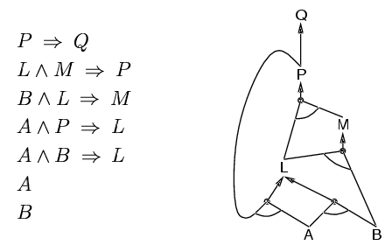
Forward chaining
Idea: fire any rule whose premises are satisfied in the KB,
  add its conclusion to the KB, until query is found or no more inferences

Slide 35
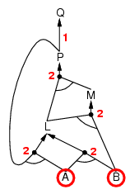
Forward chaining example

Slide 36
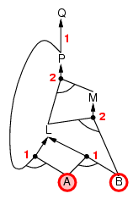
Forward chaining example

Slide 37
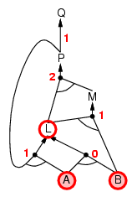
Forward chaining example

Slide 38
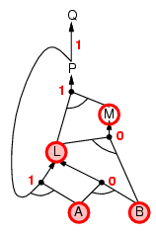
Forward chaining example

Slide 39
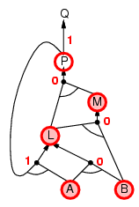
Forward chaining example

Slide 40
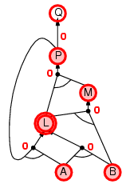
Forward chaining example

Slide 41
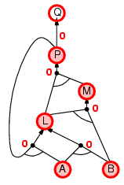
Forward chaining example

Slide 42

Forward chaining example

Slide 43
Backward chaining
Idea: work backwards from the query q
  to prove q by BC:
    check if q is known already, or
    prove by BC all premises of some rule concluding q
Avoid infinite loops: check if new subgoal is already on the goal stack
Avoid repeated work: check if new subgoal
  has already been proved true, or
  has already failed

Slide 44
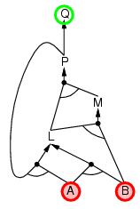
Backward chaining example

Slide 45
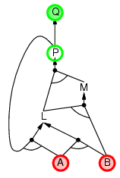
Backward chaining example

Slide 46
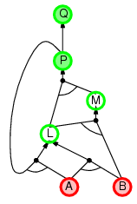
Backward chaining example

Slide 47
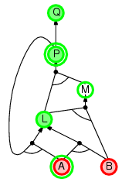
Backward chaining example

Slide 48
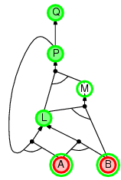
Backward chaining example

Slide 49
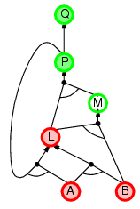
Backward chaining example

Slide 50
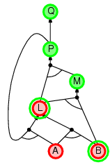
Backward chaining example

Slide 51
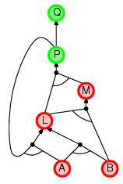
Backward chaining example

Slide 52
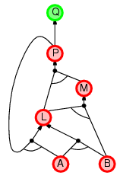
Backward chaining example

Slide 53
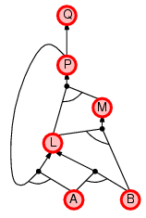
Backward chaining example

Slide 54
Forward vs. backward chaining
FC is data-driven, appropriate for deriving conclusions from incoming percepts,
  e.g., object recognition, routine decisions
May do lots of work that is irrelevant to the goal
BC is goal-driven, appropriate for problem-solving,
  e.g., Where are my keys? How do I get into a PhD program?
Complexity of BC can be much less than linear in size of KB

Slide 55
Summary
Logical agents apply inference to a knowledge base to derive new information and make decisions
Basic concepts of logic:
  syntax: formal structure of sentences
  semantics: truth of sentences w.r.t. models
  entailment: necessary truth of one sentence given another
  inference: deriving sentences from other sentences
  soundness: derivations produce only entailed sentences
  completeness: derivations can produce all entailed sentences
Resolution is complete for propositional logic
Forward, backward chaining are linear-time, complete for Horn clauses
Propositional logic lacks expressive power
  Wumpus world requires the ability to represent universal relationships, etc.

